Slide 1
Unity Clicker Game

Slide 2
유니티 실행하기

Slide 3
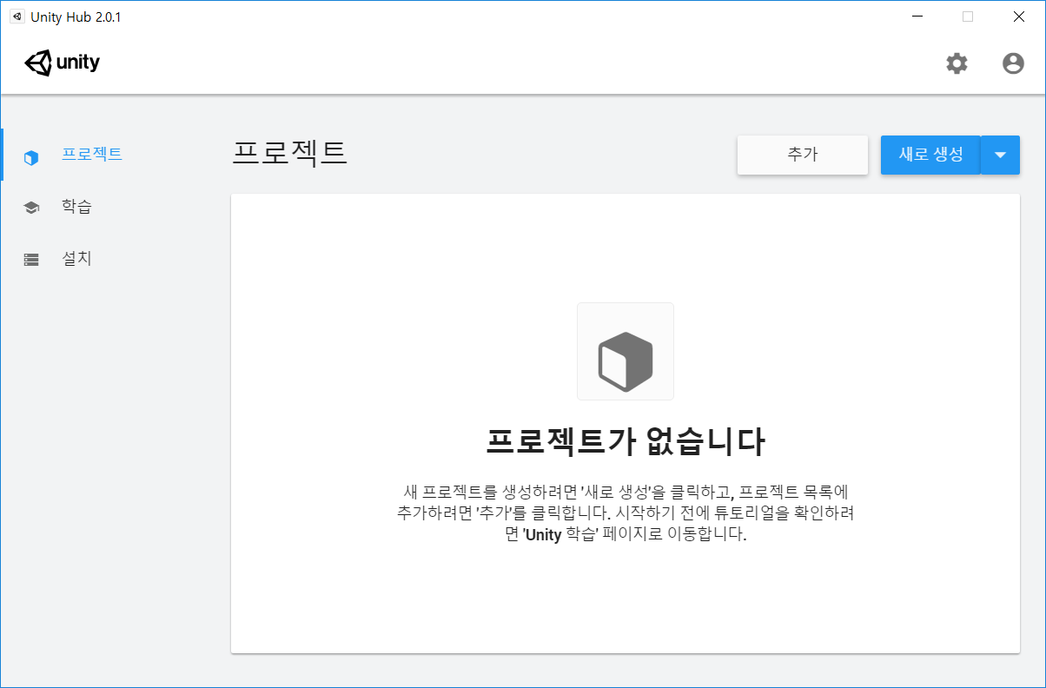
유니티 허브 실행

Slide 4
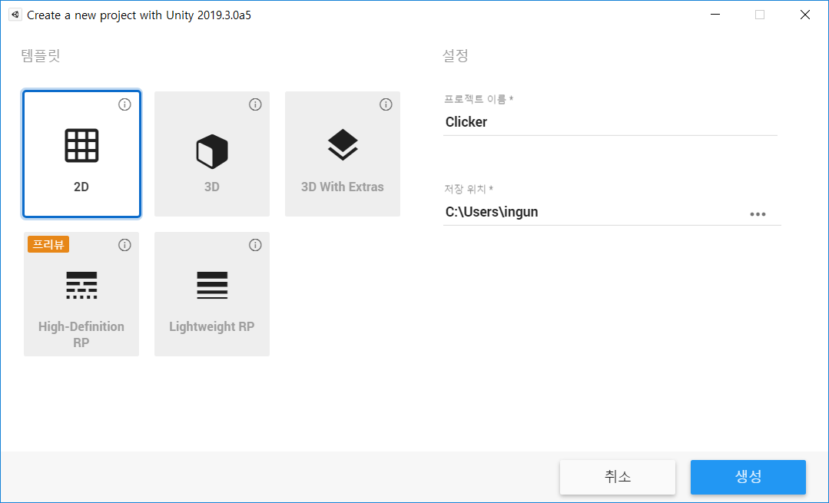
프로젝트 생성

Slide 5
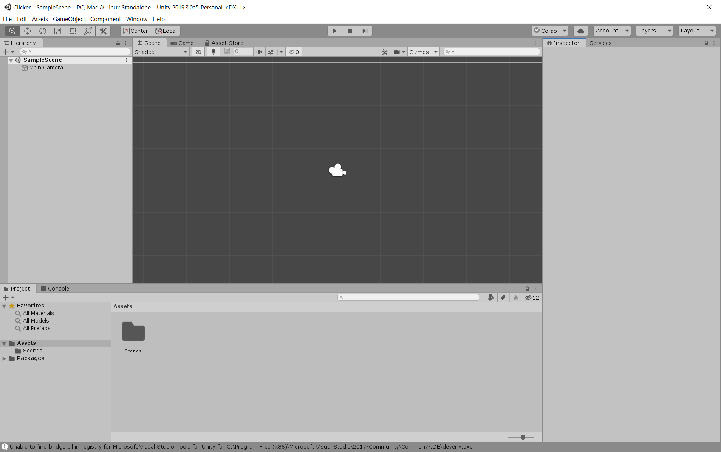
유니티 실행화면

Slide 6
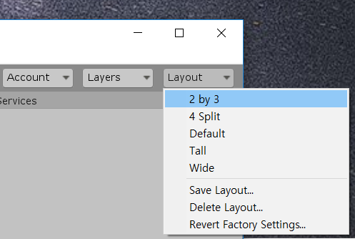
레이아웃 수정

Slide 7
더하기 버튼 만들기

Slide 8
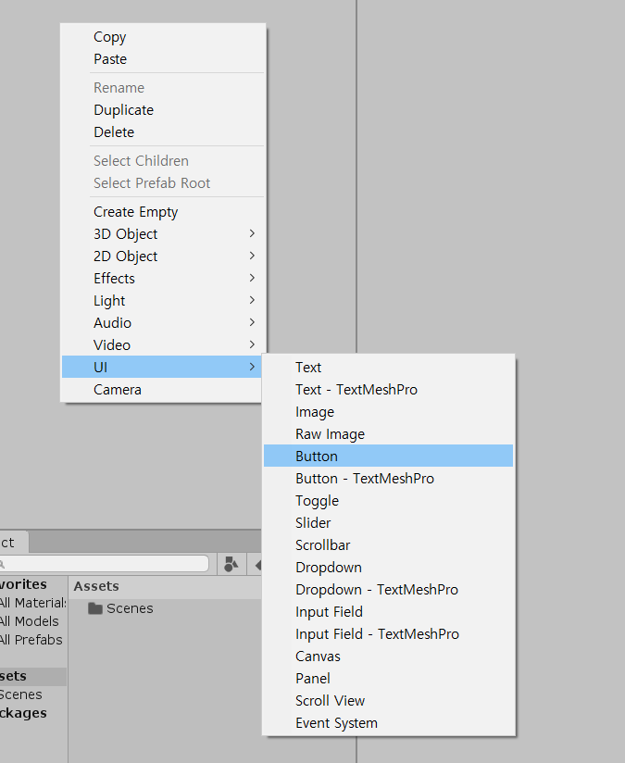

Slide 9
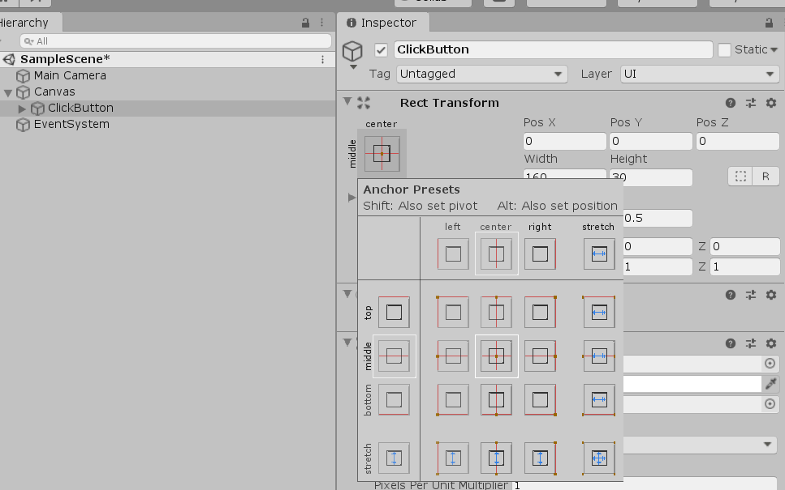
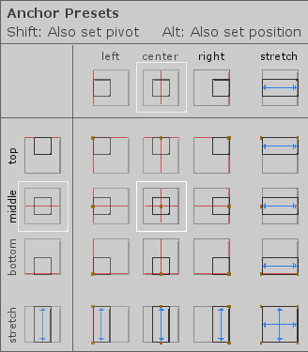
버튼 생성
Alt를 누른 뒤 Anchor Presets – Center 선택

Slide 10
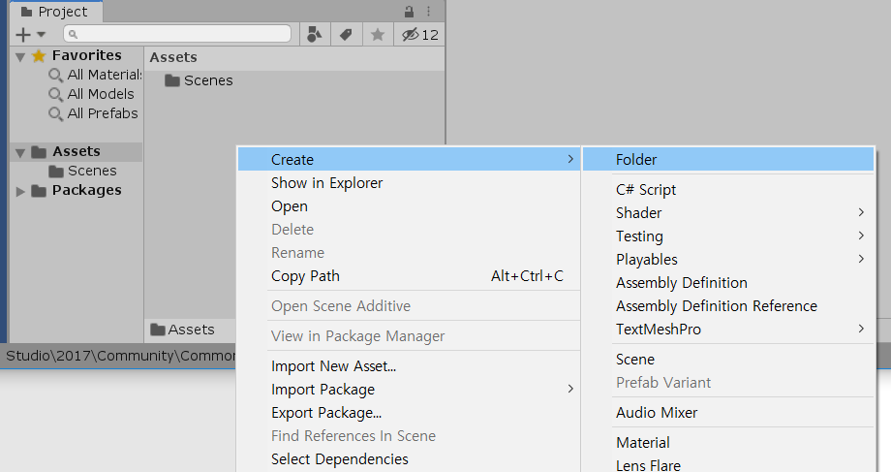
Script 폴더 추가

Slide 11
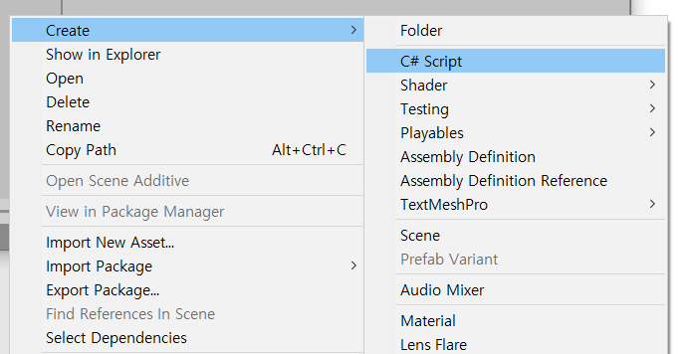
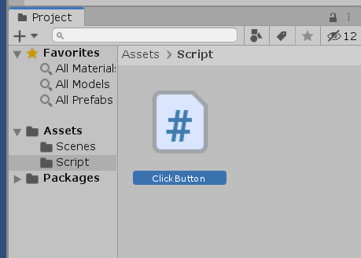
C# 스크립트 추가

Slide 12
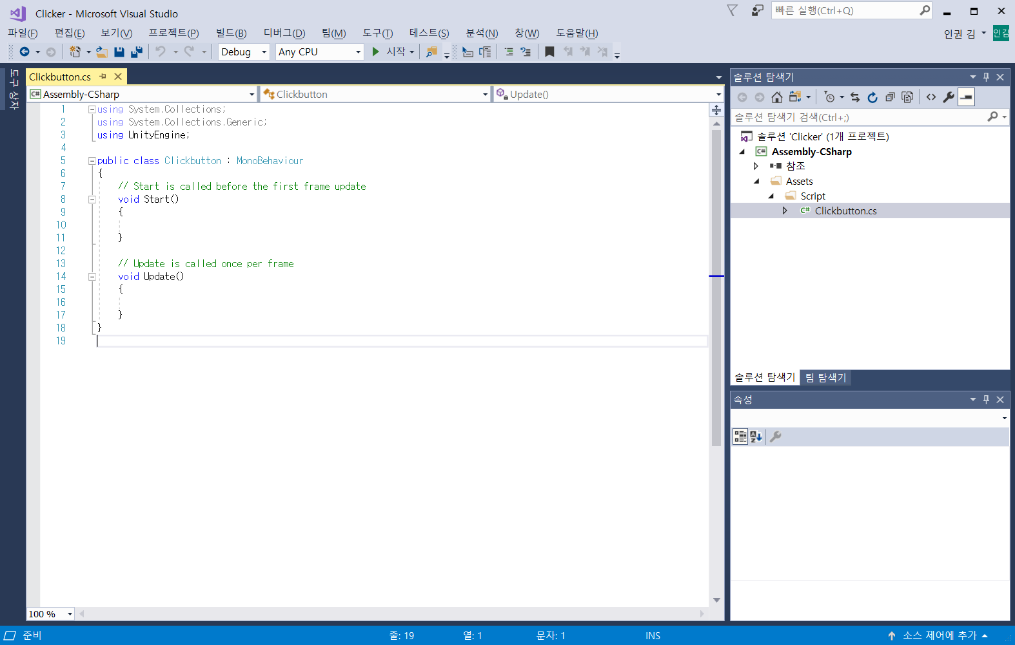
Visual Studio 실행

Slide 13
ClickButton.cs
using System.Collections;
using System.Collections.Generic;
using UnityEngine;
public class ClickButton : MonoBehaviour
{
public int gold = 0; //골드 변수
public int goldPerClick = 1; //클릭 당 골드 변수
public void OnClick()
{
gold = gold + goldPerClick; //골드 합계
}
}

Slide 14
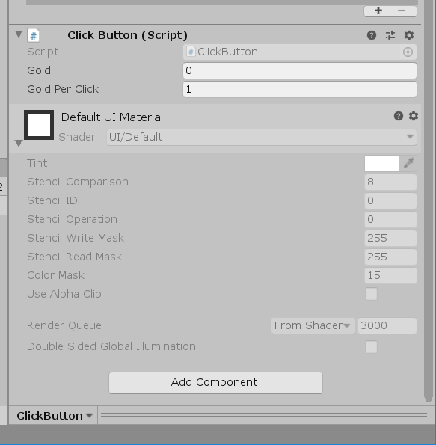
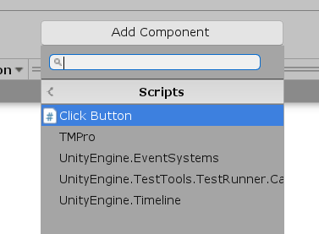
Component 추가하기
ClickButton에 ClickButton 스크립트 추가

Slide 15
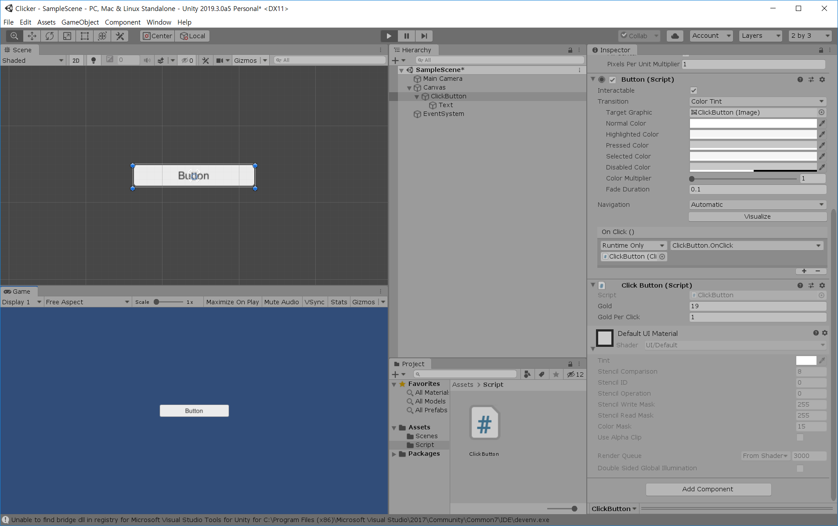
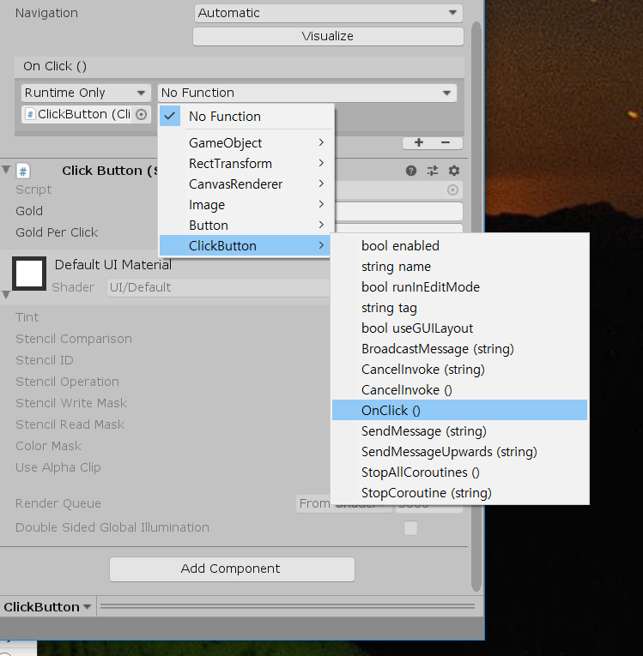
OnClick() 수행함수
Hierarchy에서 ClickButton Drag
Function에서 OnClick() 함수 선택

Slide 16
Data Controller를 이용해 저장 만들기

Slide 17
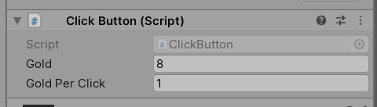
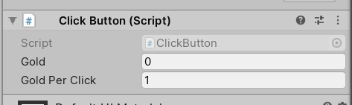
Hierarchy, Script Project
Click시 기능은 작동하지만 프로세스를 종료한 뒤 다시 접속하면 초기화 되는 문제 발생
PlayerPrefs를 이용해 GetInt와 SetInt를 이용해 로컬에 데이터 저장하는 방식 채택
변수들을 DataController에서 통합 관리

Slide 18
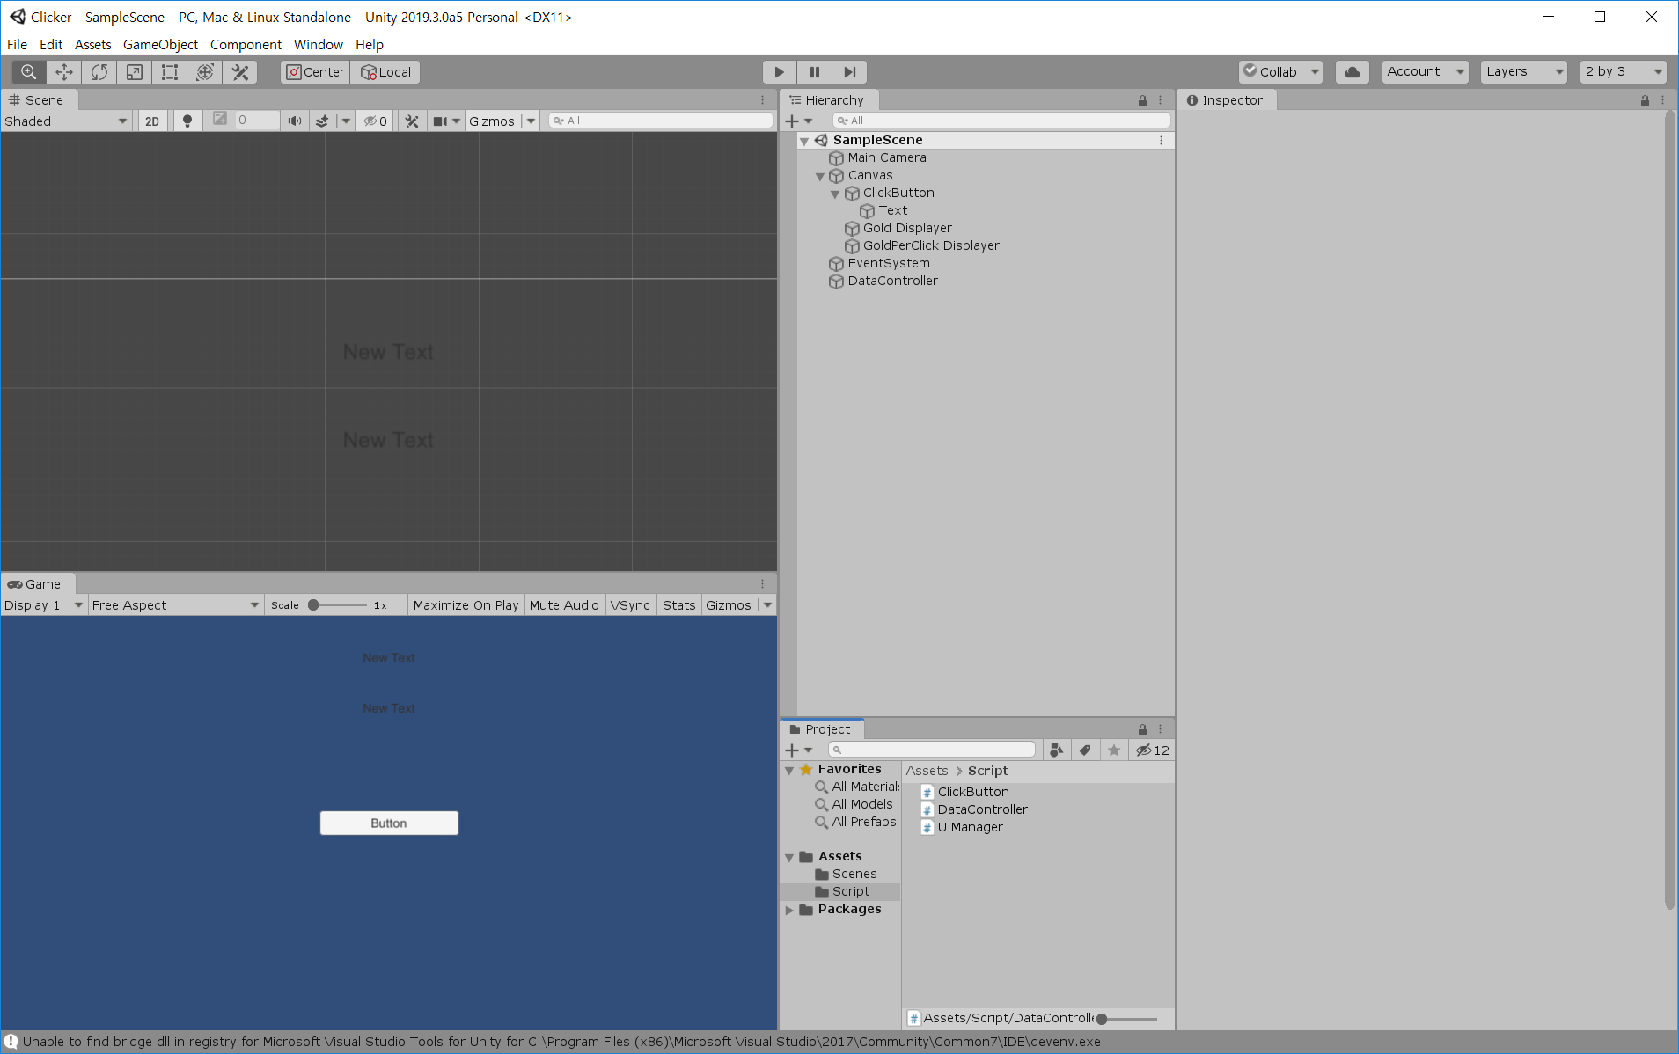
Hierarchy, Script Project
화면에 현재 골드를 보여주기 위한 Displayer 추가
UIManager, DataController 스크립트 추가
ClickButton 스크립트 수정
Empty Object로 DataController Object 추가

Slide 19
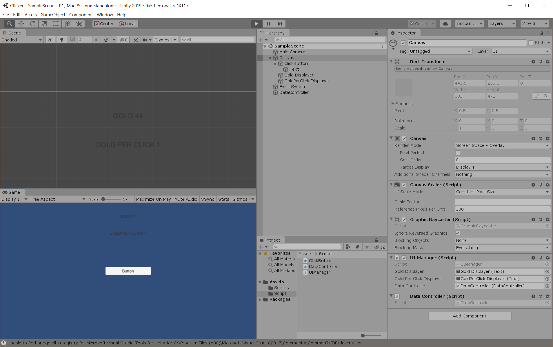
Scene, Canvas Component
GoldDisplayer, ClickPerGoldDisplayer배치

Slide 20
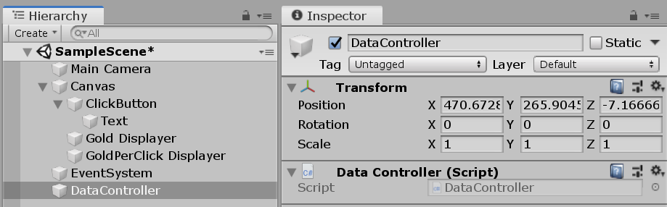
Scene, Canvas Component

Slide 21
DataController.cs
using System.Collections;
using System.Collections.Generic;
using UnityEngine;
public class DataController : MonoBehaviour
{
private int m_gold = 0;
private int m_goldPerClick = 0;
//Load
void Awake()
{
m_gold = PlayerPrefs.GetInt("Gold");
m_goldPerClick = PlayerPrefs.GetInt("GoldPerClick", 1);
}
//Save
public void SetGold(int newGold)
{
m_gold = newGold;
PlayerPrefs.SetInt("Gold", m_gold);
}
public void AddGold(int newGold)
{
//m_gold =
m_gold += newGold;
SetGold(m_gold);
}
public void SubGold(int newGold)
{
m_gold -= newGold;
SetGold(m_gold);
}
public int GetGold()
{
return m_gold;
}
public int GetGoldPerClick()
{
return m_goldPerClick;
}
public void SetGoldPerClick(int newGoldPerClick)
{
m_goldPerClick = newGoldPerClick;
PlayerPrefs.SetInt("GoldPerClick", m_goldPerClick);
}
}

Slide 22
ClickButton.cs
using System.Collections;
using System.Collections.Generic;
using UnityEngine;
public class ClickButton : MonoBehaviour
{
public DataController dataController;
public void OnClick()
{
int goldPerClick = dataController.GetGoldPerClick();
dataController.AddGold(goldPerClick);
}
}
기존 변수로 작동하던 클릭 버튼 클래스를 데이터 컨트롤러를 이용해 데이터를 저장 변경하는 것으로 변경

Slide 23
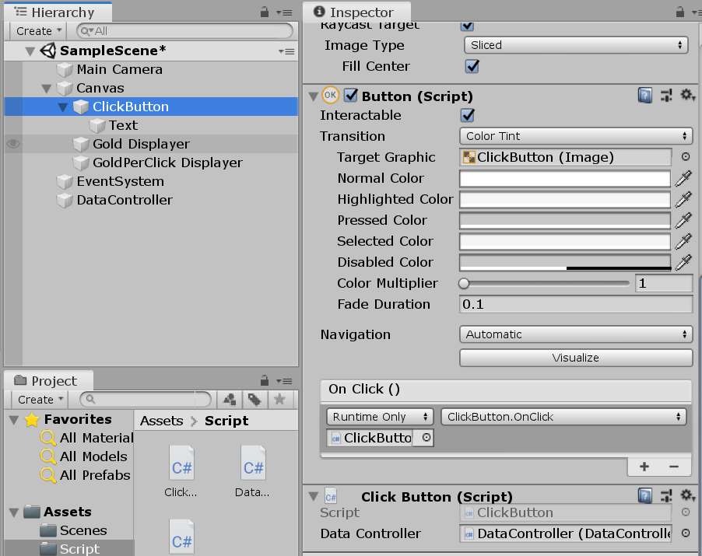
ClickButton Scene, Canvas Component

Slide 24
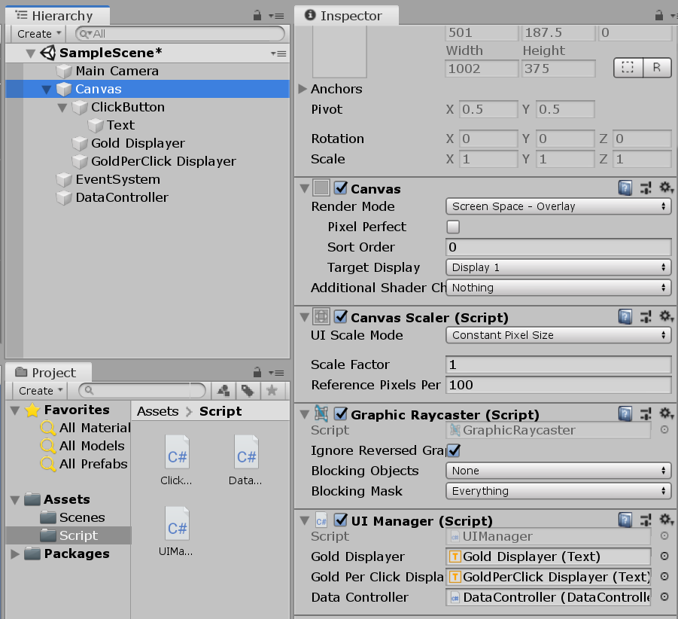
UIManager Component

Slide 25
UIManager.cs
using System.Collections;
using System.Collections.Generic;
using UnityEngine;
using UnityEngine.UI;
public class UIManager : MonoBehaviour
{
public Text goldDisplayer; //Text 변수 선언 주의
public Text goldPerClickDisplayer;
public DataController dataController;
void Update()
{
goldDisplayer.text = "Gold " + dataController.GetGold();
goldPerClickDisplayer.text = "Gold Per Click " + dataController.GetGoldPerClick();
}
}

Slide 26
결과

Slide 27
Upgrade 만들기

Slide 28
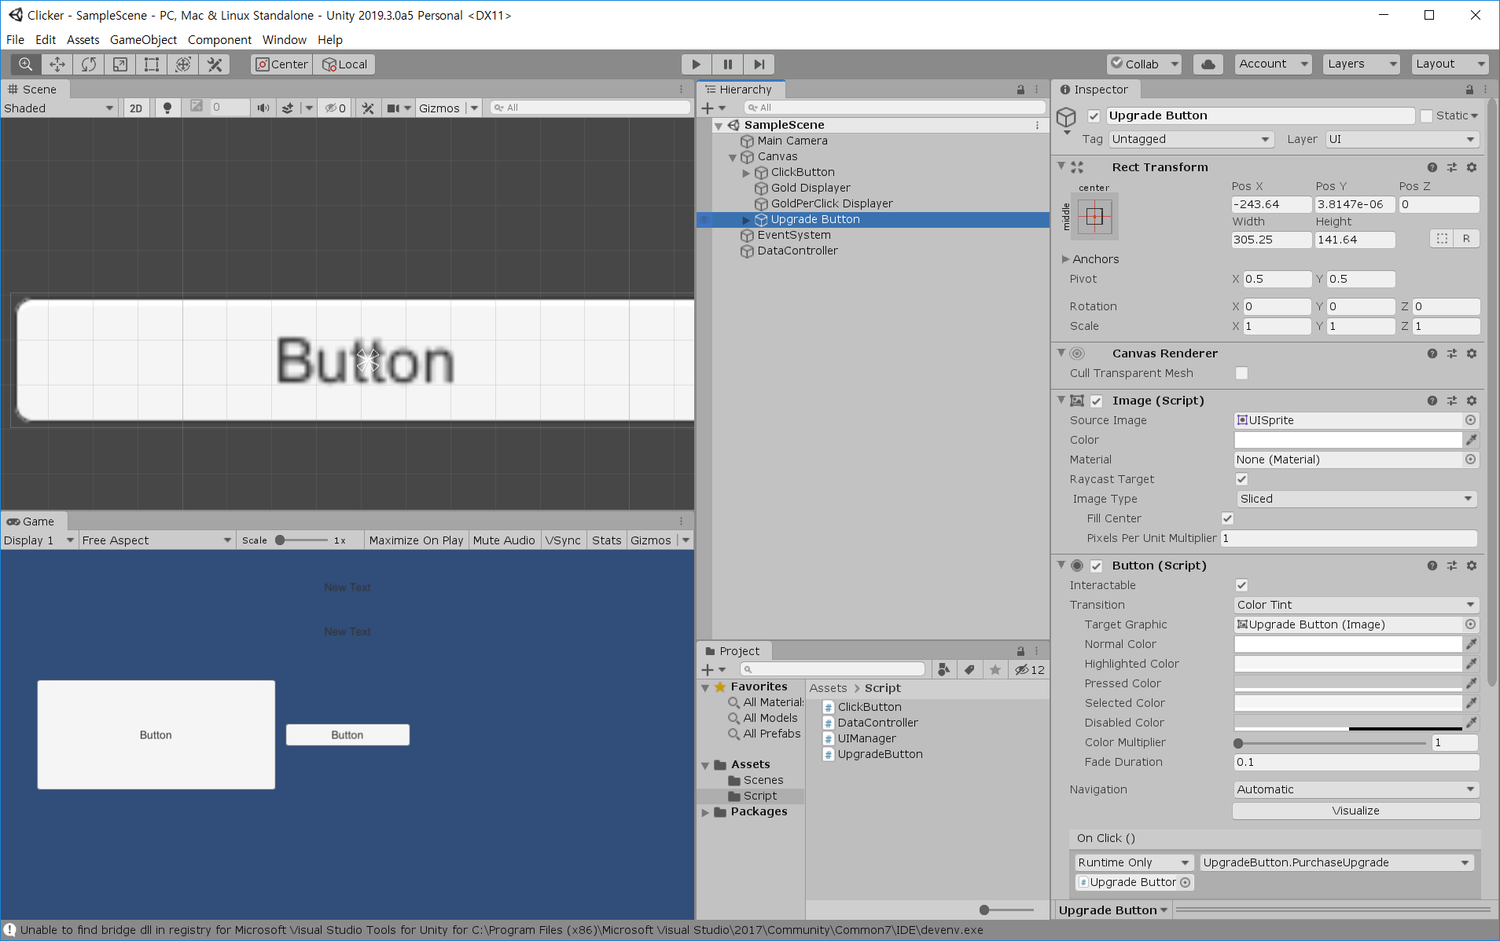
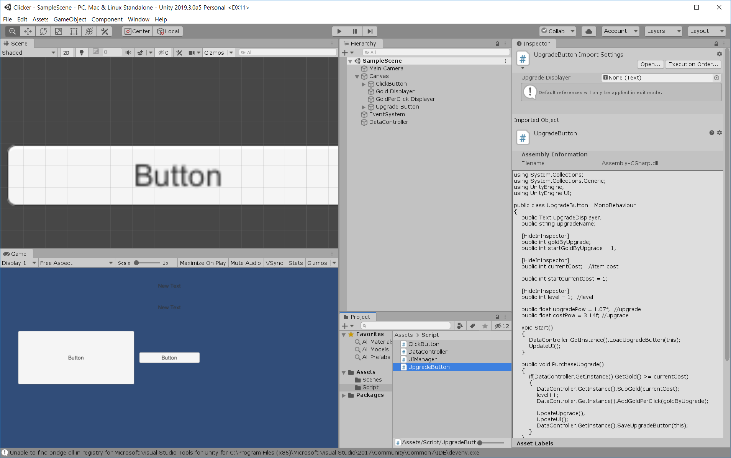
Hierarchy, Script Project
UpgradeButton Object 및 Script 추가

Slide 29
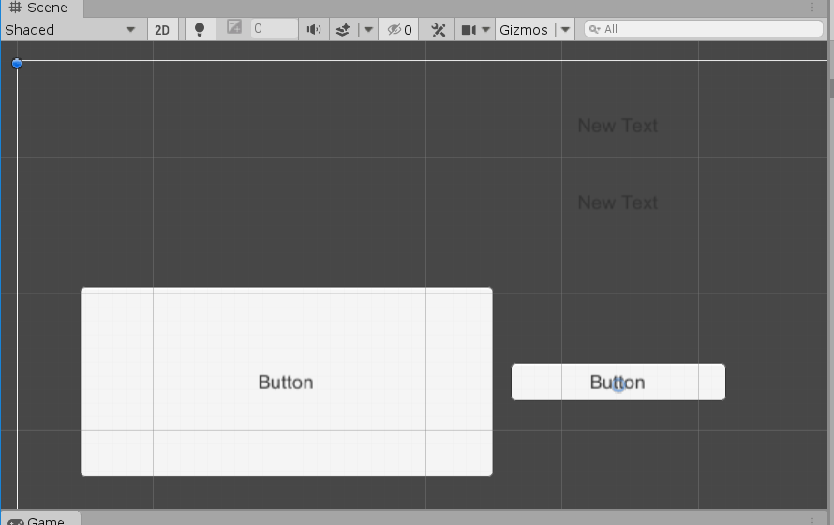
Scene, Canvas Component

Slide 30
DataController.cs
using System.Collections;
using System.Collections.Generic;
using UnityEngine;
public class DataController : MonoBehaviour
{
private int m_gold = 0; //DataController의 변수를 외부에서 쉽게 바꾸지 못하도록 private 변수로 선언
private int m_goldPerClick = 0;
//게임시작시 데이터는 Load, 이벤트 마다 데이터 Save를 한다.
//Data Load
void Awake()
{
m_gold = PlayerPrefs.GetInt("Gold");
m_goldPerClick = PlayerPrefs.GetInt("GoldPerClick", 1);
}
//Data Save
public void SetGold(int newGold) //골드 Data Set 함수
{
m_gold = newGold;
PlayerPrefs.SetInt("Gold", m_gold);
}
public void AddGold(int newGold) //골드 증가 함수
{
m_gold = m_gold + newGold;
//m_gold += newgold;
SetGold(m_gold);
}
public void SubGold(int newGold) //골드 감소 함수
{
m_gold = m_gold - newGold;
//m_gold -= newgold;
SetGold(m_gold);
}
public int GetGold() //골드 값 반환
{
return m_gold;
}
public int GetGoldPerClick() //클릭당 골드값 반환
{
return m_goldPerClick;
}
public void SetGoldPerClick(int newGoldPerClick) //클릭당 골드 Data Set 함수 void, int 주의하기
{
m_goldPerClick = newGoldPerClick;
PlayerPrefs.SetInt("GoldPerClick", m_goldPerClick);
}
public void AddGoldPerClick(int newGoldPerClick)
{
m_goldPerClick += newGoldPerClick;
SetGoldPerClick(m_goldPerClick);
}
public void LoadUpgradeButton(UpgradeButton upgradeButton)
{
string key = upgradeButton.upgradeName;
upgradeButton.level = PlayerPrefs.GetInt(key + "_level", 1);
upgradeButton.goldByUpgrade = PlayerPrefs.GetInt(key + "_goldByUpgrade", upgradeButton.startGoldByUpgrade);
upgradeButton.currentCost = PlayerPrefs.GetInt(key + "_cost", upgradeButton.startCurrentCost);
}
public void SaveUpgradeButton(UpgradeButton upgradeButton)
{
string key = upgradeButton.upgradeName;
PlayerPrefs.SetInt(key + "_level", upgradeButton.level);
PlayerPrefs.SetInt(key + "_goldByUpgrade", upgradeButton.goldByUpgrade);
PlayerPrefs.SetInt(key + "_cost", upgradeButton.currentCost);
}
}

Slide 31
UpgradeButton.cs
using System.Collections;
using System.Collections.Generic;
using UnityEngine;
using UnityEngine.UI;
public class UpgradeButton : MonoBehaviour
{
public DataController dataController;
public Text upgradeDisplayer;
public string upgradeName;
public int goldByUpgrade;
public int startGoldByUpgrade = 1;
public int currentCost; //item cost
public int startCurrentCost = 1;
public int level = 1; //level
public float upgradePow = 2.07f; //upgrade 이후 클릭당 얻는 비용
public float costPow = 3.14f; //upgrade 가격
void Start()
{
dataController.LoadUpgradeButton(this);
UpdateUI();
}
public void PurchaseUpgrade()
{
if (dataController.GetGold() >= currentCost)
{
dataController.SubGold(currentCost);
level = level + 1;
dataController.AddGoldPerClick(goldByUpgrade);
UpdateUpgrade();
UpdateUI();
dataController.SaveUpgradeButton(this);
}
}
public void UpdateUpgrade()
{
goldByUpgrade = startGoldByUpgrade * (int)Mathf.Pow(upgradePow, level);
currentCost = startCurrentCost * (int)Mathf.Pow(costPow, level);
}
public void UpdateUI()
{
upgradeDisplayer.text = upgradeName + "\nCost: " + currentCost + "\nLevel" + level + "\nAdd GoldPerClick: " + goldByUpgrade;
}
}

Slide 32
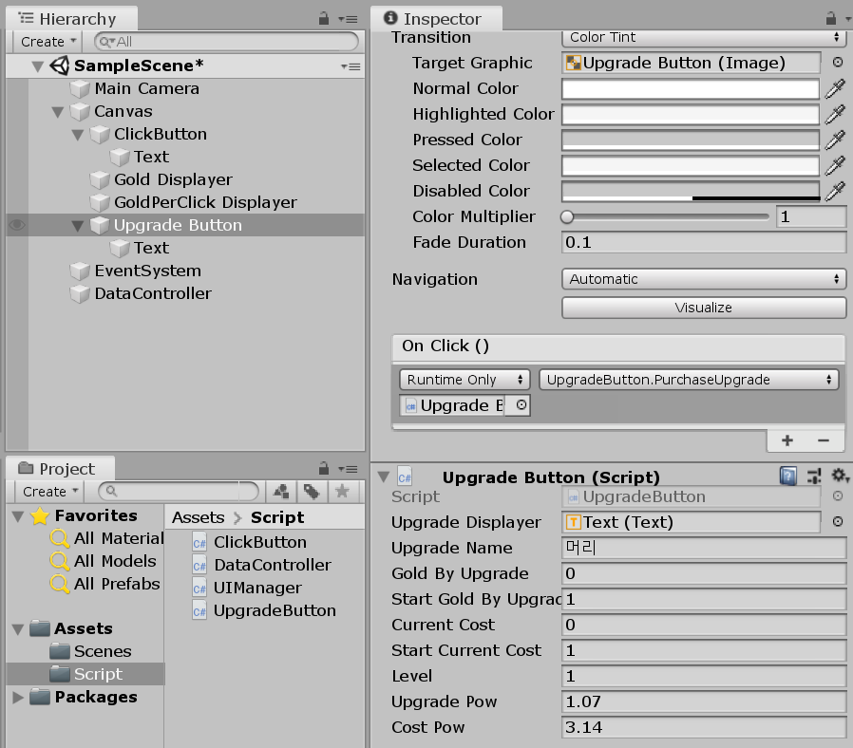
Scene, Canvas Component
On Click()
PurchaseUpgrade 함수 실행

Slide 33
ClickButton.CS
using System.Collections;
using System.Collections.Generic;
using UnityEngine;
public class ClickButton : MonoBehaviour
{
public DataController dataController;
public void OnClick()
{
int goldPerClick = dataController.GetGoldPerClick();
dataController.AddGold(goldPerClick);
}
}

Slide 34
UIManager.cs
using System.Collections;
using System.Collections.Generic;
using UnityEngine;
using UnityEngine.UI;
public class UIManager : MonoBehaviour
{
public Text goldDisplayer; //Text 변수 선언 주의
public Text goldPerClickDisplayer;
public DataController dataController;
void Update()
{
goldDisplayer.text = "Gold " + dataController.GetGold();
goldPerClickDisplayer.text = "Gold Per Click " + dataController.GetGoldPerClick();
}
}

Slide 35
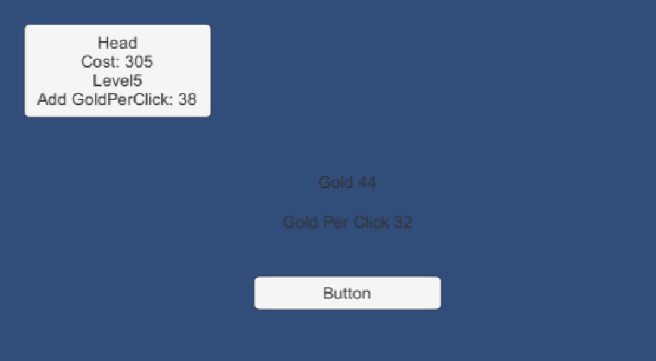
결과

Slide 36
Item 만들기

Slide 37
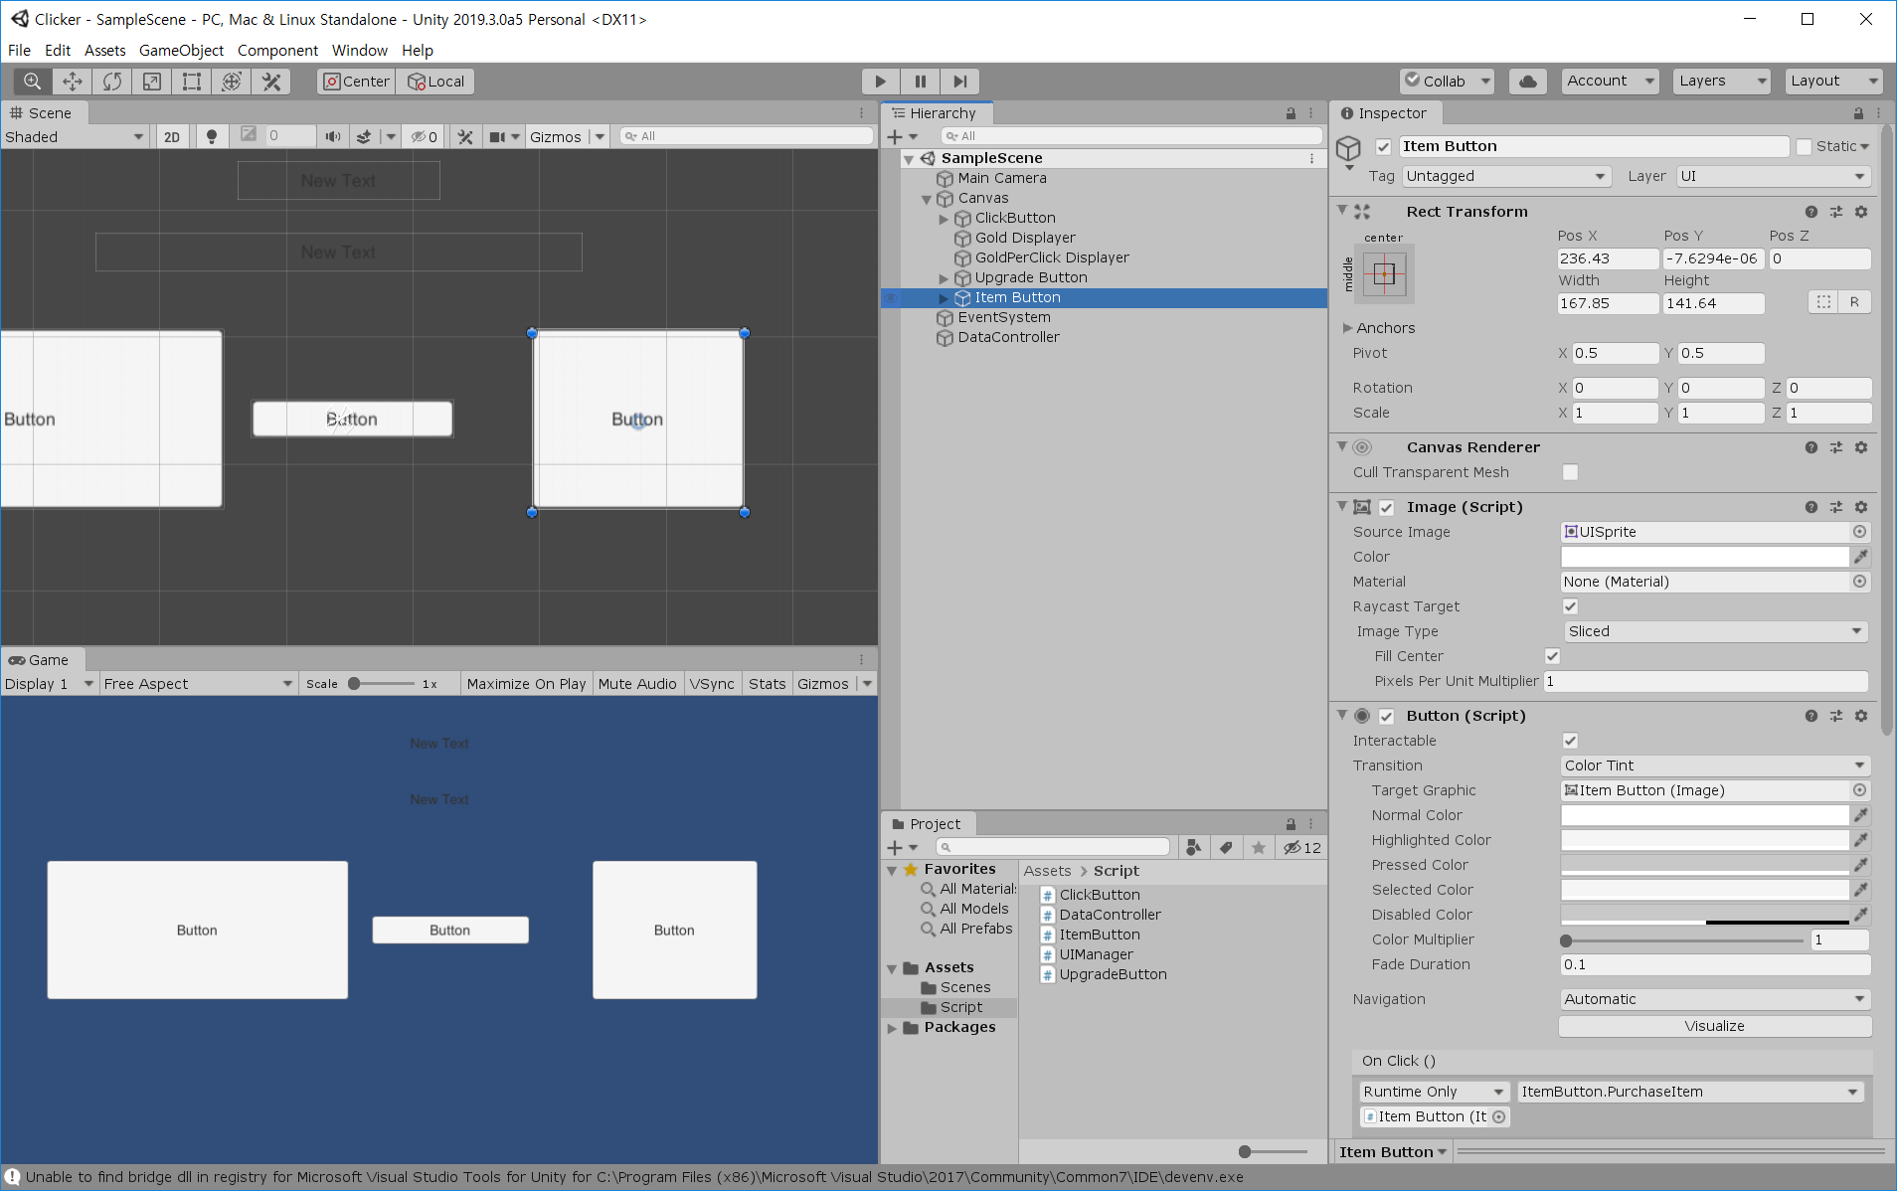
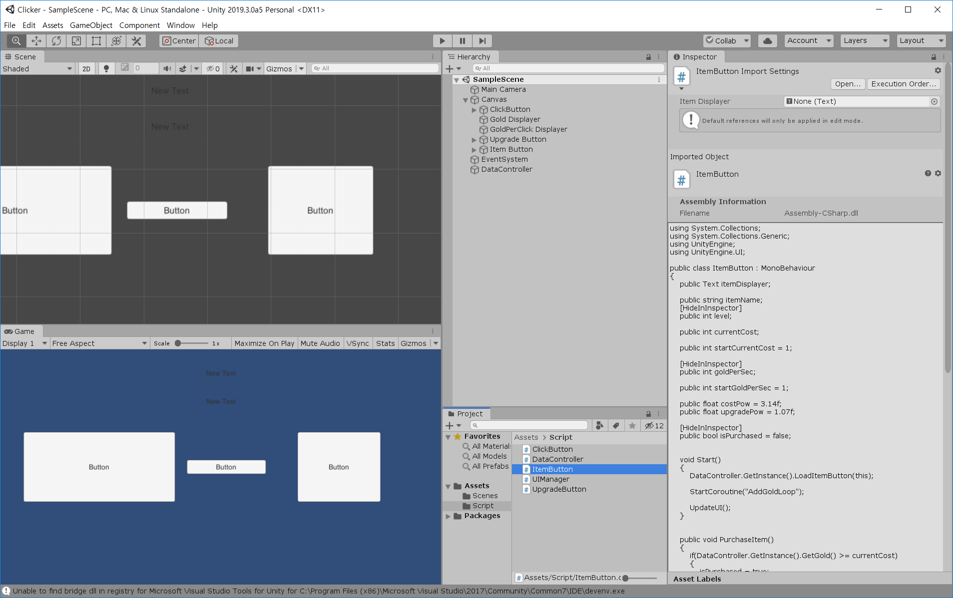
Hierarchy, Script Project

Slide 38
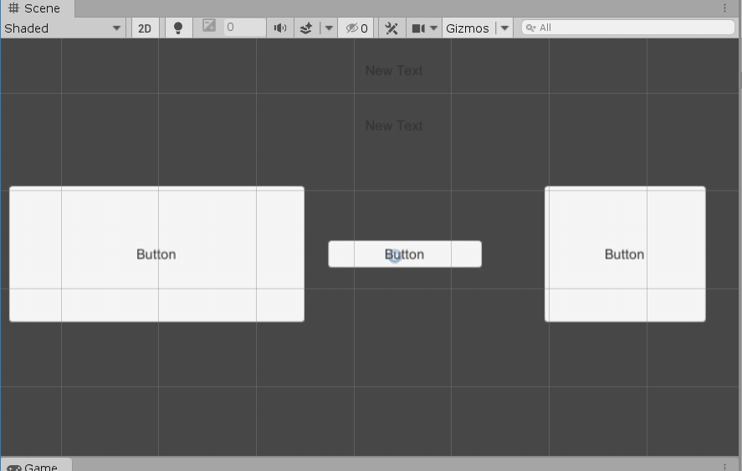
Scene

Slide 39
DataController.cs
using System.Collections;
using System.Collections.Generic;
using UnityEngine;
public class DataController : MonoBehaviour
{
private int m_gold = 0; //DataController의 변수를 외부에서 쉽게 바꾸지 못하도록 private 변수로 선언
private int m_goldPerClick = 0;
//게임시작시 데이터는 Load, 이벤트 마다 데이터 Save를 한다.
//Data Load
void Awake()
{
//PlayerPrefs.DeleteAll();
m_gold = PlayerPrefs.GetInt("Gold");
m_goldPerClick = PlayerPrefs.GetInt("GoldPerClick", 1);
}
//Data Save
public void SetGold(int newGold) //골드 Data Set 함수
{
m_gold = newGold;
PlayerPrefs.SetInt("Gold", m_gold);
}
public void AddGold(int newGold) //골드 증가 함수
{
m_gold = m_gold + newGold;
//m_gold += newgold;
SetGold(m_gold);
}
public void SubGold(int newGold) //골드 감소 함수
{
m_gold = m_gold - newGold;
//m_gold -= newgold;
SetGold(m_gold);
}
public int GetGold() //골드 값 반환
{
return m_gold;
}
public int GetGoldPerClick() //클릭당 골드값 반환
{
return m_goldPerClick;
}
public void SetGoldPerClick(int newGoldPerClick) //클릭당 골드 Data Set 함수 void, int 주의하기
{
m_goldPerClick = newGoldPerClick;
PlayerPrefs.SetInt("GoldPerClick", m_goldPerClick);
}
// 클릭당 골드
public void AddGoldPerClick(int newGoldPerClick)
{
m_goldPerClick = m_goldPerClick + newGoldPerClick;
SetGoldPerClick(m_goldPerClick);
}
public void LoadUpgradeButton(UpgradeButton upgradeButton)
{
string key = upgradeButton.upgradeName;
upgradeButton.level = PlayerPrefs.GetInt(key + "_level", 1);
upgradeButton.goldByUpgrade = PlayerPrefs.GetInt(key + "_goldByUpgrade", upgradeButton.startGoldByUpgrade);
upgradeButton.currentCost = PlayerPrefs.GetInt(key + "_cost", upgradeButton.startCurrentCost);
}
public void SaveUpgradeButton(UpgradeButton upgradeButton)
{
string key = upgradeButton.upgradeName;
PlayerPrefs.SetInt(key + "_level", upgradeButton.level);
PlayerPrefs.SetInt(key + "_goldByUpgrade", upgradeButton.goldByUpgrade);
PlayerPrefs.SetInt(key + "_cost", upgradeButton.currentCost);
}
// 초당 골드
public void LoadItemButton(ItemButton itemButton)
{
string key = itemButton.itemName;
itemButton.level = PlayerPrefs.GetInt(key + "_level");
itemButton.currentCost = PlayerPrefs.GetInt(key + "_cost", itemButton.startCurrentCost);
itemButton.goldPerSec = PlayerPrefs.GetInt(key + "_goldPerSec");
if (PlayerPrefs.GetInt(key + "_isPurchased") == 1)
{
itemButton.isPurchased = true;
}
else
{
itemButton.isPurchased = false;
}
}
public void SaveItemButton(ItemButton itemButton)
{
string key = itemButton.itemName;
PlayerPrefs.SetInt(key + "_level", itemButton.level);
PlayerPrefs.SetInt(key + "_cost", itemButton.currentCost);
PlayerPrefs.SetInt(key + "_goldPerSec", itemButton.goldPerSec);
if (itemButton.isPurchased == true)
{
PlayerPrefs.SetInt(key + "_isPurchased", 1); //구매 하면 1로 Set
}
else
{
PlayerPrefs.SetInt(key + "_isPurchased", 0); //구매 하지 않으면 0으로 Set
}
}
}

Slide 40
ItemButton.cs
using System.Collections;
using System.Collections.Generic;
using UnityEngine;
using UnityEngine.UI;
public class ItemButton : MonoBehaviour
{
public DataController dataController;
public Text itemDisplayer;
public string itemName;
public int level;
public int currentCost;
public int startCurrentCost = 1;
public int goldPerSec;
public int startGoldPerSec = 1;
public float costPow = 3.14f;
public float upgradePow = 1.07f;
public bool isPurchased = false;
void Start()
{
dataController.LoadItemButton(this);
StartCoroutine("AddGoldLoop");
UpdateUI();
}
public void PurchaseItem() //아이템 구매
{
if(dataController.GetGold() >=currentCost)
{
isPurchased = true;
dataController.SubGold(currentCost);
level = level + 1;
UpdateItem();
UpdateUI();
dataController.SaveItemButton(this);
}
}
IEnumerator AddGoldLoop() //초당 골드 획득
{
while(true)
{
if(isPurchased)
{
dataController.AddGold(goldPerSec);
}
yield return new WaitForSeconds(1.0f);
}
}
public void UpdateItem() //아이템 정보 업데이트
{
goldPerSec = goldPerSec + startGoldPerSec * (int)Mathf.Pow(upgradePow, level); //초당 획득 골드량 업데이트
currentCost = startGoldPerSec * (int)Mathf.Pow(costPow, level); //아이템 레벨업 비용
}
public void UpdateUI()
{
itemDisplayer.text = itemName + "\nLevel: " + level + "\ncost: " + currentCost + "\nGold Per Sec: " + goldPerSec + "\nIsPurchased: " + isPurchased;
}
}

Slide 41
UIManager.cs
using System.Collections;
using System.Collections.Generic;
using UnityEngine;
using UnityEngine.UI;
public class UIManager : MonoBehaviour
{
public Text goldDisplayer; //Text 변수 선언 주의
public Text goldPerClickDisplayer;
public DataController dataController;
void Update()
{
goldDisplayer.text = "Gold " + dataController.GetGold();
goldPerClickDisplayer.text = "Gold Per Click " + dataController.GetGoldPerClick();
}
}

Slide 42
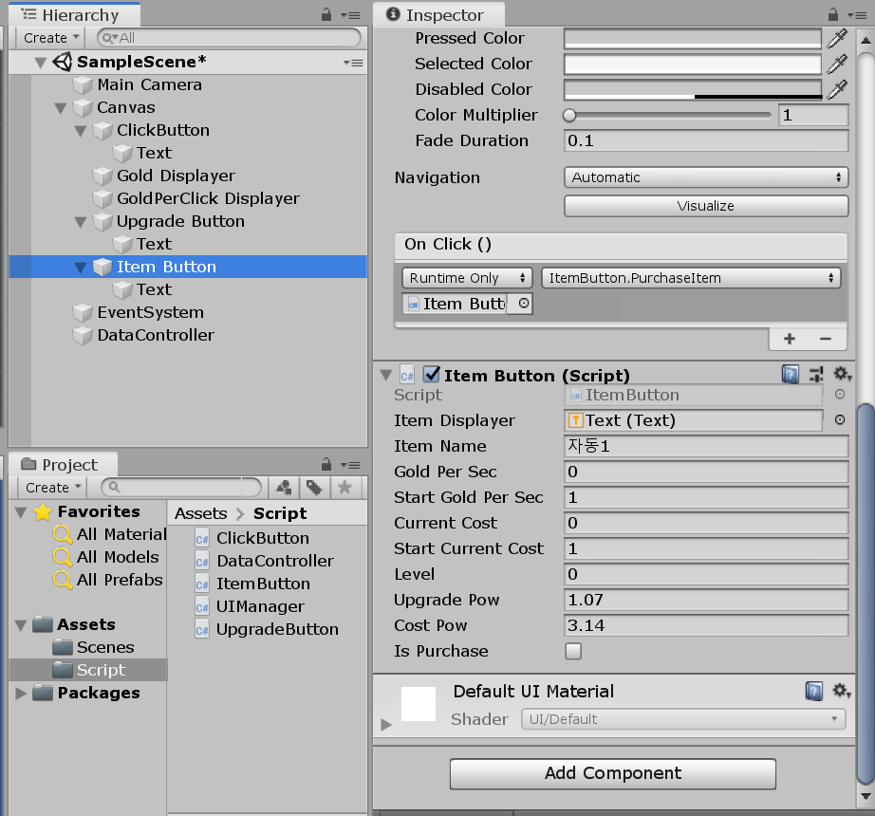
Item Button

Slide 43
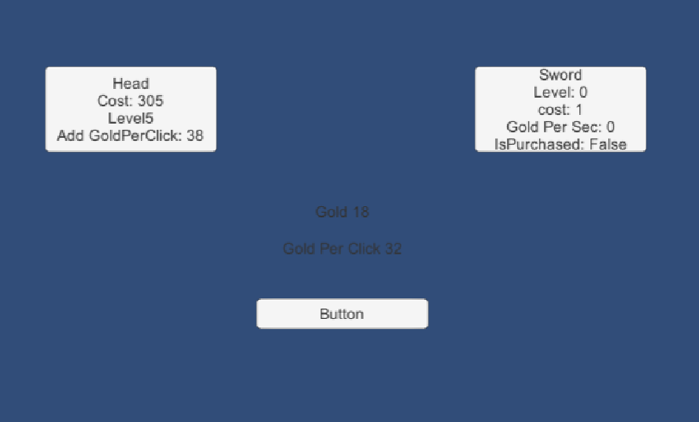
결과

Slide 44
UI 수정

Slide 45
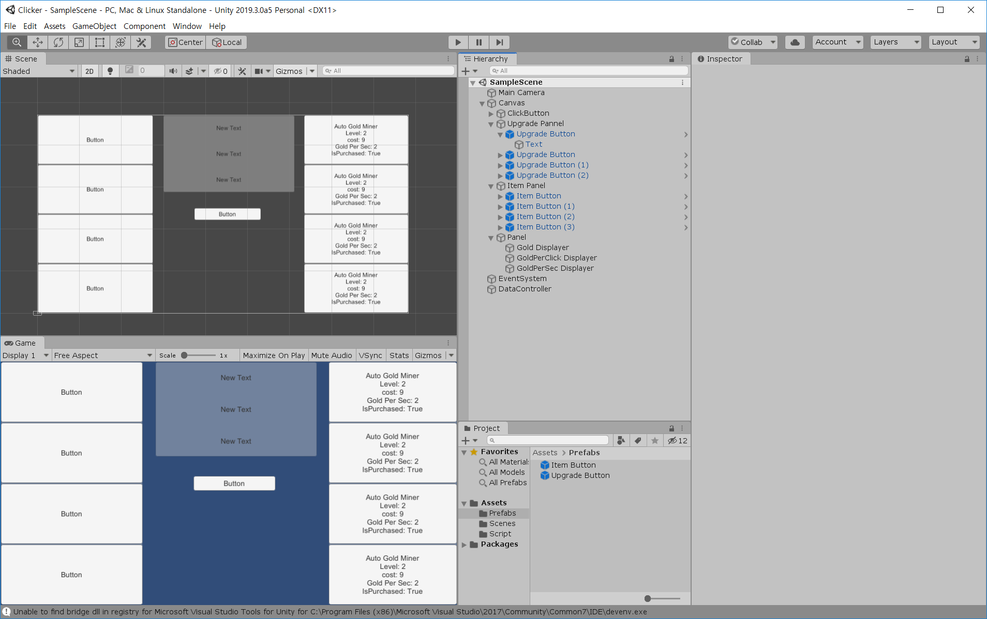

Hierarchy, Prefabs Project

Slide 46
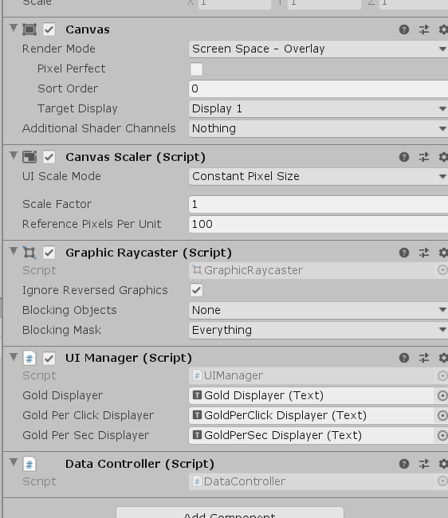
Scene, Canvas Component

Slide 47
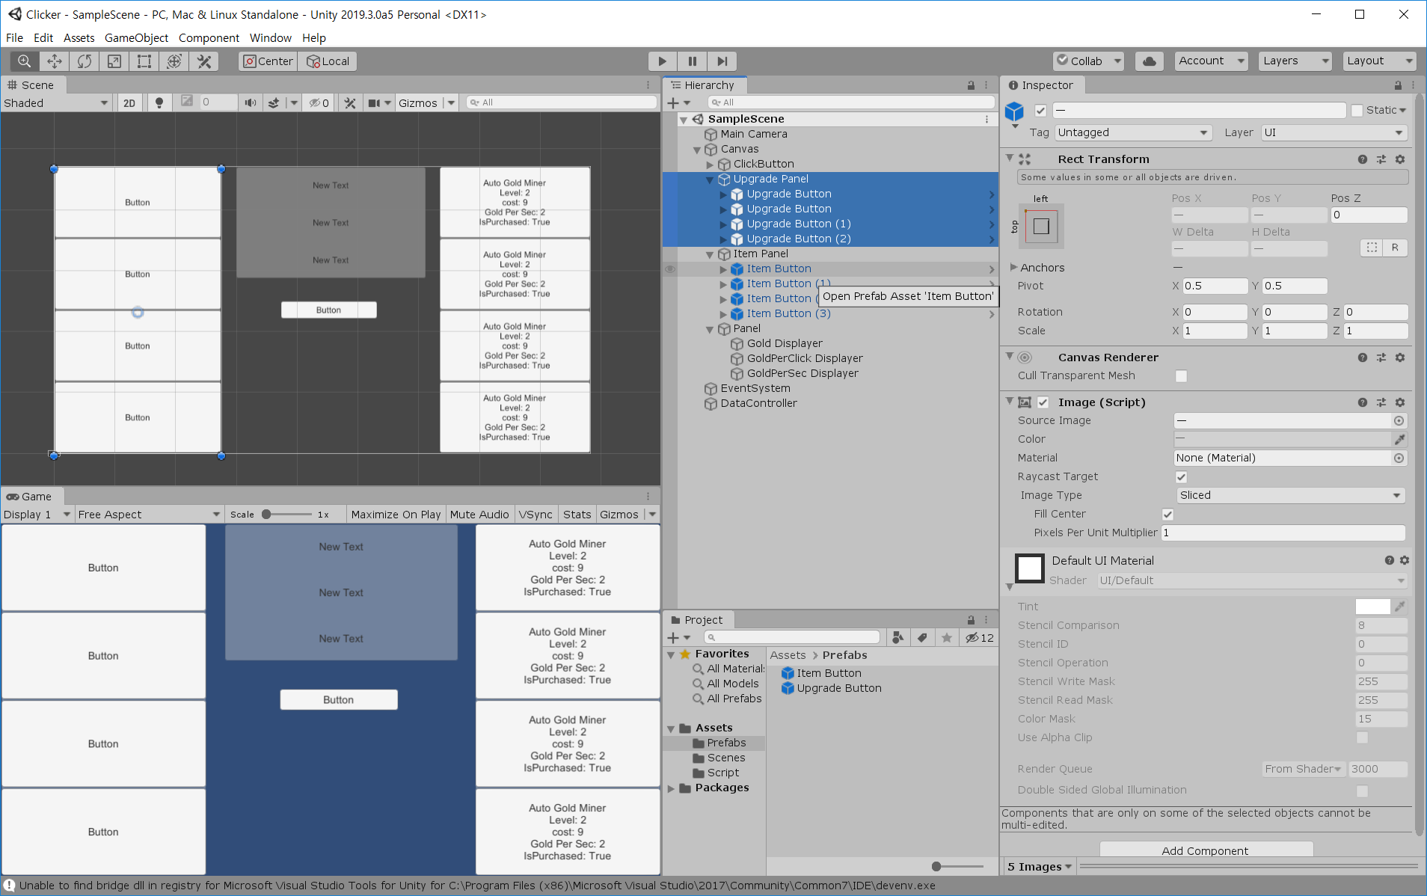
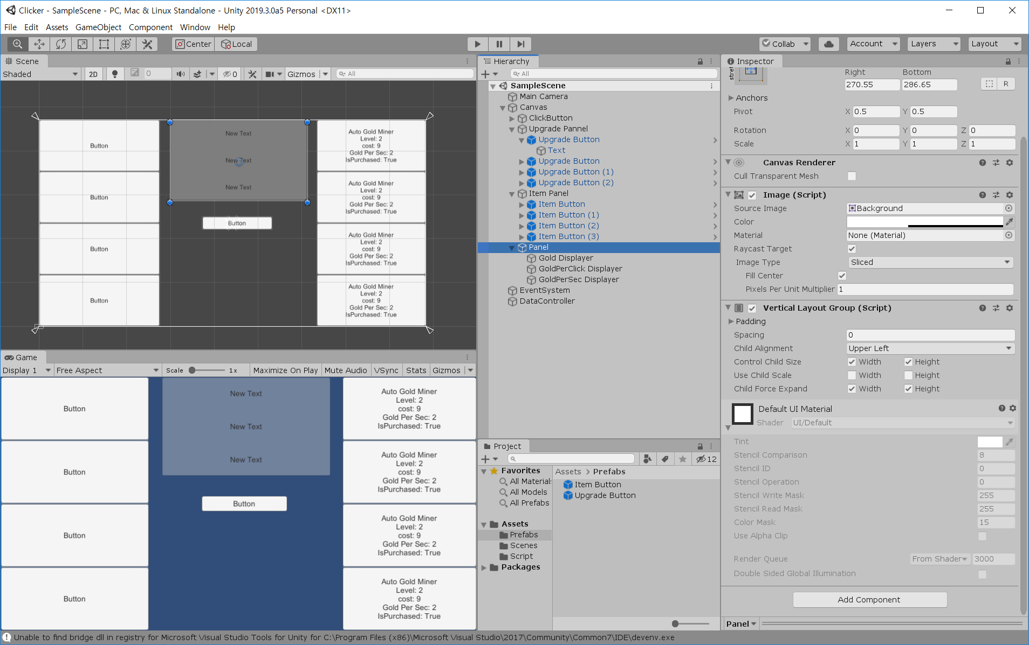
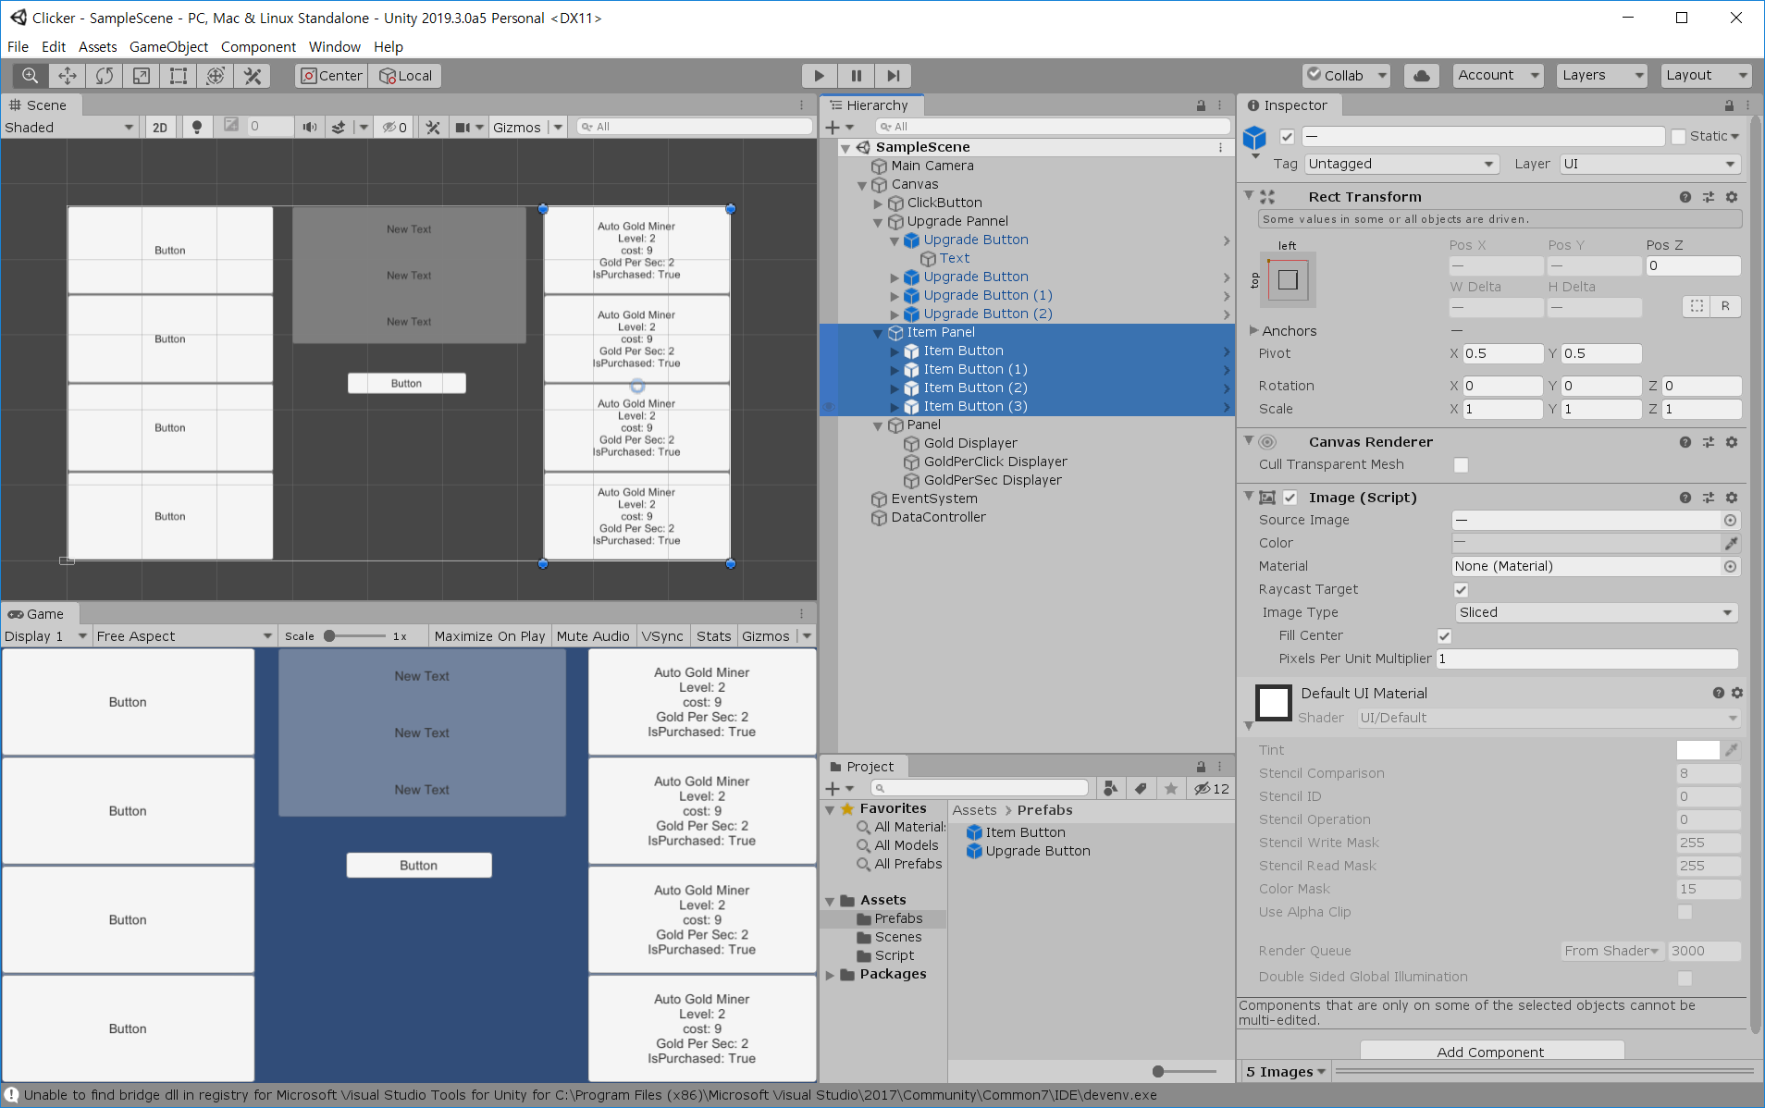
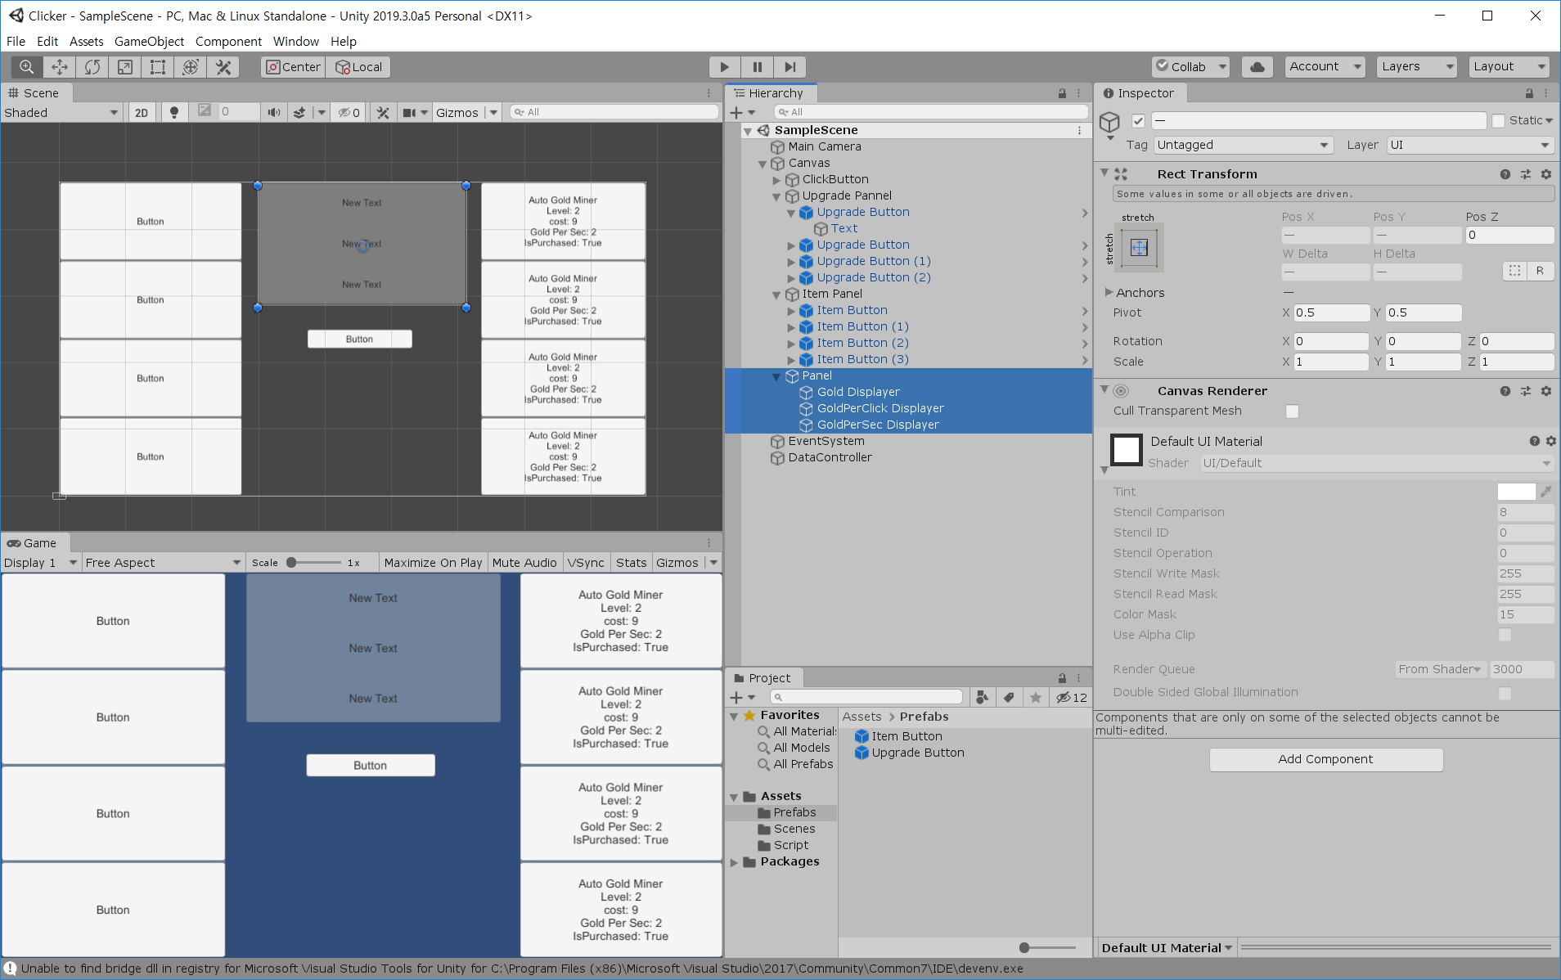
Panel

Slide 48
DataController.cs
using System.Collections;
using System.Collections.Generic;
using UnityEngine;
public class DataController : MonoBehaviour
{
//static 만들기
private static DataController instance;
public static DataController GetInstance()
{
if (instance == null)
{
instance = FindObjectOfType<DataController>();
if(instance == null)
{
GameObject container = new GameObject("DataController");
instance = container.AddComponent<DataController>();
}
}
return instance;
}
private ItemButton[] itemButtons;
private int m_gold = 0;
private int m_goldPerClick = 0;
//Gold Load
void Awake()
{
//PlayerPrefs.DeleteAll();
m_gold = PlayerPrefs.GetInt("Gold");
m_goldPerClick = PlayerPrefs.GetInt("GoldPerClick", 1);
itemButtons = FindObjectsOfType<ItemButton>(); //objects
}
//Gold Save
public void SetGold(int newGold)
{
m_gold = newGold;
PlayerPrefs.SetInt("Gold", m_gold);
}
public void AddGold(int newGold)
{
//m_gold =
m_gold += newGold;
SetGold(m_gold);
}
public void SubGold(int newGold)
{
m_gold = m_gold - newGold;
SetGold(m_gold);
}
public int GetGold()
{
return m_gold;
}
public int GetGoldPerClick()
{
return m_goldPerClick;
}
public void SetGoldPerClick(int newGoldPerClick)
{
m_goldPerClick = newGoldPerClick;
PlayerPrefs.SetInt("GoldPerClick", m_goldPerClick);
}
public void AddGoldPerClick(int newGoldPerClick)
{
m_goldPerClick += newGoldPerClick;
SetGoldPerClick(m_goldPerClick);
}
public void LoadUpgradeButton(UpgradeButton upgradeButton)
{
string key = upgradeButton.upgradeName;
upgradeButton.level = PlayerPrefs.GetInt(key + "_level", 1);
upgradeButton.goldByUpgrade = PlayerPrefs.GetInt(key + "_goldByUpgrade", upgradeButton.startGoldByUpgrade);
upgradeButton.currentCost = PlayerPrefs.GetInt(key + "_cost", upgradeButton.startCurrentCost);
}
public void SaveUpgradeButton(UpgradeButton upgradeButton)
{
string key = upgradeButton.upgradeName;
PlayerPrefs.SetInt(key + "_level", upgradeButton.level);
PlayerPrefs.SetInt(key + "_goldByUpgrade", upgradeButton.goldByUpgrade);
PlayerPrefs.SetInt(key + "_cost", upgradeButton.currentCost);
}
public void LoadItemButton(ItemButton itemButton)
{
string key = itemButton.itemName;
itemButton.level = PlayerPrefs.GetInt(key + "_level");
itemButton.currentCost = PlayerPrefs.GetInt(key + "_cost", itemButton.startCurrentCost);
itemButton.goldPerSec = PlayerPrefs.GetInt(key + "_goldPerSec");
if(PlayerPrefs.GetInt(key + "_isPurchased") == 1)
{
itemButton.isPurchased = true;
}
else
{
itemButton.isPurchased = false;
}
}
public void SaveItemButton(ItemButton itemButton)
{
string key = itemButton.itemName;
PlayerPrefs.SetInt(key + "_level", itemButton.level);
PlayerPrefs.SetInt(key + "_cost", itemButton.currentCost);
PlayerPrefs.SetInt(key + "_goldPerSec", itemButton.goldPerSec);
if (itemButton.isPurchased == true)
{
PlayerPrefs.SetInt(key + "_isPurchased", 1);
}
else
{
PlayerPrefs.SetInt(key + "_isPurchased", 0);
}
}
public int GetGoldPerSec()
{
int goldPerSec = 0;
for(int i=0; i< itemButtons.Length; i++)
{
goldPerSec += itemButtons[i].goldPerSec;
}
return goldPerSec;
}
}

Slide 49
UIManage.cs
using System.Collections;
using System.Collections.Generic;
using UnityEngine;
using UnityEngine.UI;
public class UIManager : MonoBehaviour
{
public Text goldDisplayer;
public Text goldPerClickDisplayer;
public Text goldPerSecDisplayer;
void Update()
{
goldDisplayer.text = "GOLD " + DataController.GetInstance().GetGold();
goldPerClickDisplayer.text = "GOLD PER CLICK " + DataController.GetInstance().GetGoldPerClick();
goldPerSecDisplayer.text = "GOLD PER SEC: " + DataController.GetInstance().GetGoldPerSec();
}
}

Slide 50
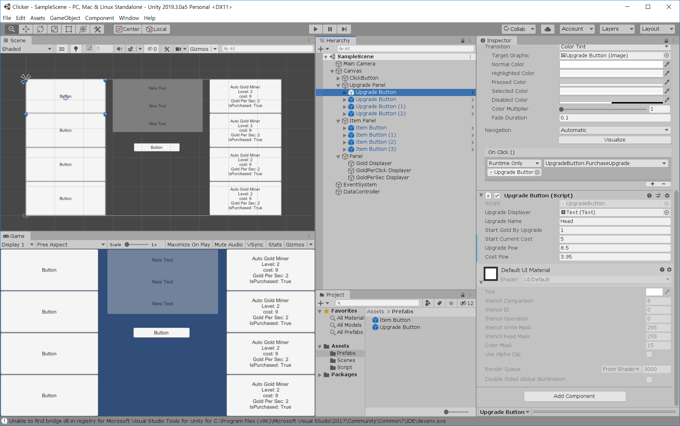
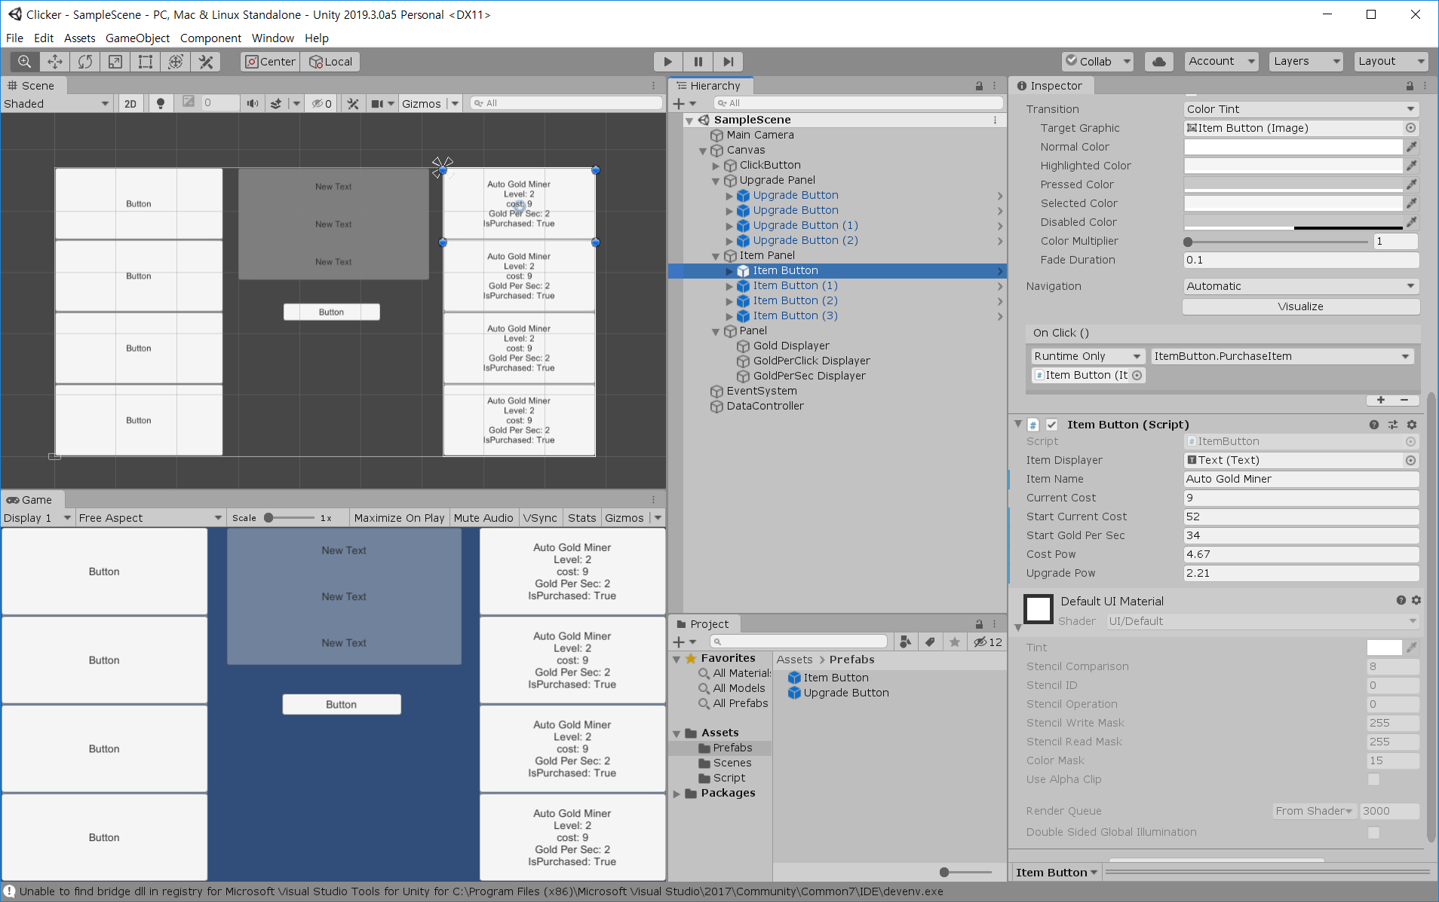
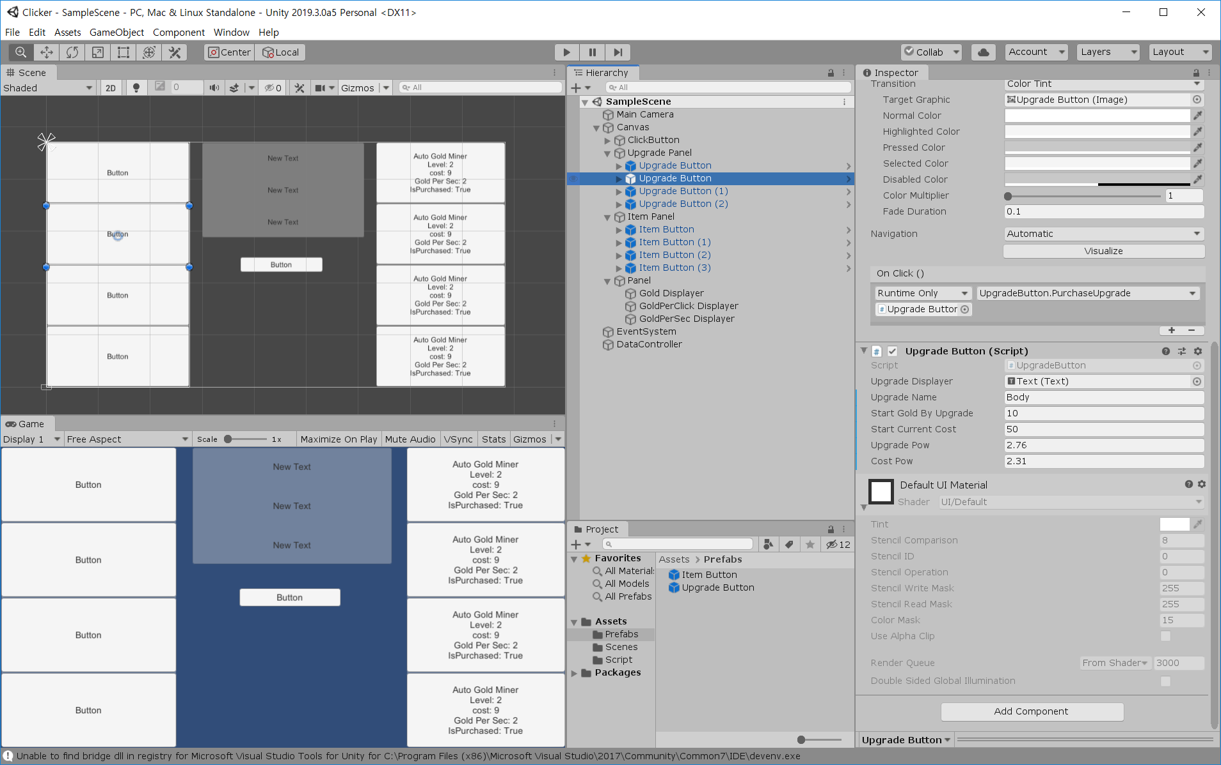


Slide 51
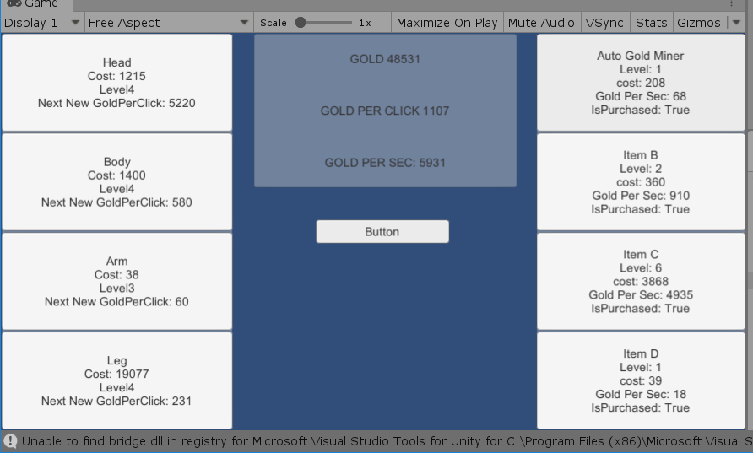
결과

Slide 52
파트 별 Try
Game Design : 성장 Balancing
Programming : Data Parsing(json, xml)
Art : UI Design

